Slide 1

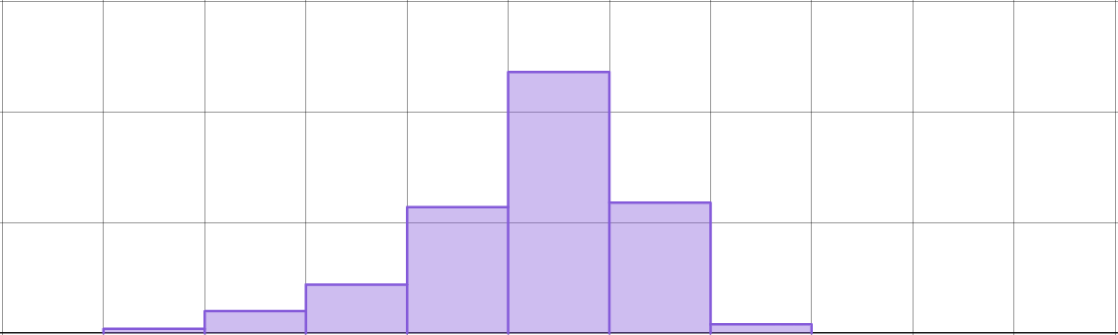
Studying climate change
Task A: Comparing data between different periods of time
1) The graphs show data from the Met Office and OSI SAF about sea ice in the Arctic for each month from 1979 to 2024.
150
1979 to 2001
frequency
100
50
0
-3
-2.5
-2
-1.5
-1
-0.5
0
0.5
1
1.5
2
150
2002 to 2024
frequency
100
50
0
-3
-2.5
-2
-1.5
-1
-0.5
0
0.5
1
1.5
2
Horizontal axes show the monthly Arctic sea ice extent expressed as a difference from the 1981-2010 average for each month separately (million km²).
a) What was the modal class for 1979 to 2001?
b) What was the modal class for 2002 to 2024?
c) Did the extent of sea ice generally increase or decrease between the two periods of time? Explain your answer.

Slide 2


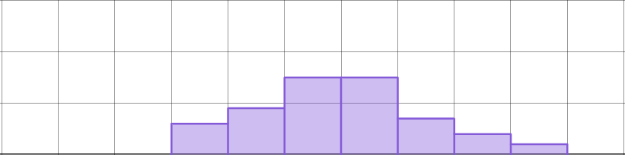
Studying climate change
2) The graphs show data from the Met Office and HadSST4 about sea-surface temperatures for each year from 1851 to 2024.
30
1851 to 1908
frequency
20
10
0
-1
-0.8
-0.6
-0.4
-0.2
0
0.2
0.4
0.6
0.8
1
30
1909 to 1966
frequency
20
10
0
-1
-0.8
-0.6
-0.4
-0.2
0
0.2
0.4
0.6
0.8
1
30
1967 to 2024
frequency
20
10
0
-1
-0.8
-0.6
-0.4
-0.2
0
0.2
0.4
0.6
0.8
1
Horizontal axes show the annual global mean sea-surface temperature expressed as a difference from 1981-2010 average (°C).
Compare the sea-surface temperatures for the three periods of time. Describe any conclusions that you can draw from the data.
‹#›

Slide 3
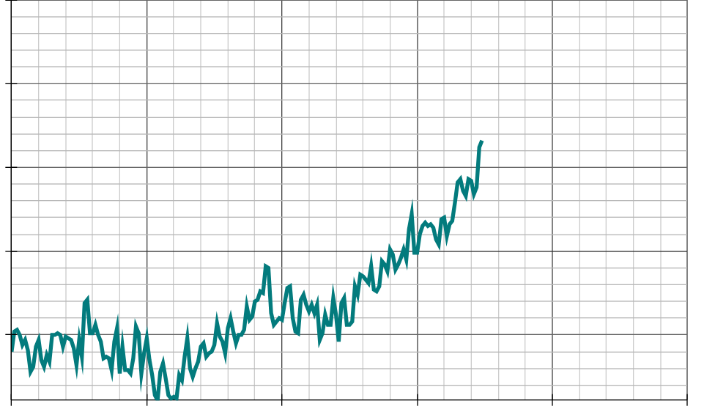
Studying climate change
Task B: Using data about sea ice to make predictions
1) The graphs show data from the Met Office and HadSST4 about sea-surface temperatures for each year from 1851 to 2024.
1.5
1.0
0.5
annual global mean sea-surface temperature expressed as a difference from 1981-2010 average (°C)
0.0
-0.5
1850
1900
1950
2000
2050
2100
year
a) Write down at least two observations that you make about any trends in the data.
b) If the trend in mean global sea-surface temperatures continues in the way it has since 1970, what range of data could we expect to observe in:
i) 2040?
ii) 2050?
iii) 2060?
‹#›

Slide 4
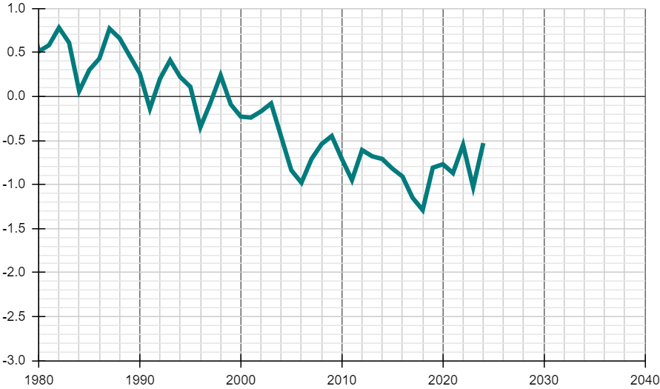
Studying climate change
2) The graph shows data from the Met Office and OSI SAF about sea ice in the Arctic for each January from 1980 to 2024.
1.0
0.5
0.0
-0.5
Arctic sea ice extent for January expressed as a difference from the 1981-2010 average for each January (million km²)
-1.5
-2.0
-2.5
-3.0
1980
1990
2000
2010
2020
2030
2040
year
a) Write down at least one observation that you make about any trends in the data.
b) If the trend in the extent of Arctic sea ice continues in the way it has since 1980, what range of data could we expect to see in:
i) 2030?
ii) 2035?
iii) 2040?
Mathematics in Education and Industry
v2.4

